Slide 1
CM 3.2: Probability Functions
Discrete Random Variables

Slide 2
Today
Discrete Random Variables
Probability Mass Function (pmf)
Cumulative Distribution Function (cdf)

Slide 3
The probability triple
Given a random experiment…
𝛀 | Sample space | What can possibly happen?
𝓕 | Set of events | What are the sane questions I can ask about this probability distribution?
𝐏 | Probability measure | Function that maps elements from 𝓕 to the interval [0,1]

Slide 4
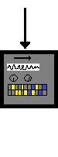
Random
Variable
Probability distribution function
𝛚
real numbers
X(𝛚) = x
probabilities
P(X(𝛚) = x)
TTHHtHT
01001000111
½ ½ ½ ½ ½
Notes:
Review
Sample space – omega are outcomes of our experiment
Two functions:
Random variable (Big X) maps outcomes (small omega) to real numbers (small x) ,
in a way that represents the Events of interest!
Probability Distribution (not density) Function maps the x’s to how probable [0,1] the associated w’s are in the sample space
! Do 1 or 2 on the board
One flip
Fraternal Twins (one girl)

Slide 5
Discrete or continuous?
A continuous rv can take any value in an interval or collection of intervals
A discrete rv can take one of a countable list of distinct values
Different things → different math required

Slide 6
pmf or pdf?
Every discrete rv has a probability mass function (pmf)
Every continuous rv has a probability density function (pdf)
Different ways of defining the function that says how probable an event is.
Notes:
Different schools of thought as to how to define
Exactly how much rain vs how much rain rounded to the nearest 100th

Slide 7
Discrete rv
Remember X is our random variable
We feed it all the 𝛚_{1, 2, …k} and it transforms each simple event into a value, call that x_{1, 2, …k}
Now each of these values is fed to the probability distribution function, which takes these x_{1, 2, …k} and tallies the number of values it sees, then divides by the total, such that we now have P(X = x_{k})
So far we have only seen this as a column in a table, but it is a function! P(X = x_{k}) = f(x_{k})
Called the probability mass function (pmf)
What must be true about this function?
Notes:
Move to picture

Slide 8
Random
Variable
Probability distribution function
𝛚_{1, 2, …k}
real numbers
X(𝛚) = x_{1, 2, …k}
probabilities
P(X(𝛚) = x)
TTHHtHT
01001000111
½ ½ ½ ½ ½
Notes:
Look for intuitions –
How big can the probabilities be??
Sum??
Min??

Slide 9
Notes:
Formalize what we know intuitively
If we sum the probabilities produced by our pdf for every value output by our Random Variable (X), it will equal 1
For every value output by our Random Variable X (x_{i}), the probability produced by our pmf will be equal to, or greater than, 0.
!!
Shorthand for P(w is an element of Omega: X(w-x))

Slide 10
For discrete X, f(x) is a
Probability Mass Function*
*It gives you a probability! (always between 0 to 1)

Slide 11
Which of these is a pmf?
✗
✗
x | f(x)
-1 | 0.3
0 | 0.3
2 | 0.3
x | f(x)
10 | -0.1
20 | 0.9
30 | 0.2
x | f(x)
1 | 0.35
2 | 0.25
3 | 0.2
4 | 0.1
5 | 0.1
x | f(x)
10 | 0.1
20 | 0.9
30 | 0.2
✗
x | f(x)
5 | 1
Notes:
X can take on any (countable) value

Slide 12
What does a pmf look like?
Table/list of numbers
Rows = x_{1, 2, …k}
Function (large n)
A plot
x-axis?
y-axis?
Notes:
x -> values
Y -> probability

Slide 13
Bernoulli rv
Special type of simple discrete rv
Two possible outcomes: success (X = 1) or failure (X = 0)
P(1) = p
P(0) = 1- p
Notes:
One of two things can happen
Think coin flip, or
Select a person (success shorter than 5’6”, failure otherwise)
Meets condition of “sum to 1”

Slide 14
Sequences of independent Bernoulli trials → other special types of discrete rvs with discrete distributions
Distribution | Definition
Binomial | Number of successes in n trials
Negative binomial | Number of failures before the x-th success
Geometric | Number of failures before the 1st success
Notes:
Can use the characteristics of the Bernoulli to build other RVs and distributions
Binomial – multiple success/fails, e.g. flip the coin many times and sum the number of successes
Negative Binomial – Flip until I get x heads – how long did that take?
Geometric – Specific negative – special case of 1st success

Slide 15
Notation
The tilde or twiddle: “~”
English: “is distributed as”
X ~ DistributionName(parameters)
Coin tossing example: X ~ Bin(n, p)
English: rv X is distributed as a binomial rv with…
n number of trials and*…
p as the single trial probability of success
*n here can be number of coins tossed, or you could have 1 coin tossed n times
Notes:
Parameters:
what parameters are needed depends on the distribution
not varying
not random
We can say everything we need to know about the results that are possible if we know the RV has a binomial dist w/n and p
Independence matters
Go to example on next slide

Slide 16



X(𝛚)
probability
H
T
1
.25
n = ?
p = ?
T
H
1
.25
𝛀
H
H
2
.25
T
T
0
.25

Slide 17
X(𝛚)
probability
H
T
1
.25
n = 2 (not an rv!)
p = .5 (parameter!)
T
H
1
.25
𝛀
H
H
2
.25
T
T
0
.25

Slide 18
X ~ Bin(2, .5): 1 experiment
In R, rbinom(number of experiments (n), number of trials per experiment (size), probability of success (prob). We’ll start with one experiment (flipping 2 coins once):
> num_exp <- 1
> num_trials <- 2
> p <- .5
> rbinom(num_exp, num_trials, p)
[1] 2
> rbinom(num_exp, num_trials, p)
[1] 0
> rbinom(num_exp, num_trials, p)
[1] 1
A little boring- but seems to work!
Let’s try flipping 2 coins 10 times…
Notes:
Discuss seeds!
Do together – up-arrow

Slide 19
X ~ Bin(2, .5): 10 experiments
> num_exp <- 10
> num_trials <- 2
> x <- rbinom(num_exp, num_trials, .5)
> length(x)
[1] 10
> table(x)
x
0 1 2
1 6 3
x | Expected P(x) | Observed P(x)
0 | 25% | 10%
1 | 50% | 60%
2 | 25% | 30%
Notes:
What would we have expected before the experiment?
What if we do more?

Slide 20
X ~ Bin(2, .5): 1,000 experiments
> num_exp <- 1000
> num_trials <- 2
> x <- rbinom(num_exp, num_trials, .5)
> length(x)
[1] 1000
> table(x)
x
0 1 2
234 512 254
x | Expected P(x) | Observed P(x)
0 | 25% | 23.4%
1 | 50% | 51.2%
2 | 25% | 25.4%

Slide 21
Let X now count the number of heads (k) in n = 30 independent coin flips…
In R:
x <- rbinom(num_exp, 2, .5)
In R:
k <- rbinom(num_exp, 30, .5)
What is the range of k?
Notes:
30

Slide 22
Binomial pmf: f_{X}(k; n, p) (equivalent notation)
Notes:
Probability that X takes on k =
Combinatoric – n choose k
n!/k!(n-k)!

Slide 23
How many ways are there to get k heads? (combination)
How likely is any particular combination of k heads and n - k tails? (multiplicative rule)
When we use the Binomial distribution we know p and n and the distribution describes the probabilities for all the ks we could have.
Notes:
Show it with a non 50-50 probability??

Slide 24
X ~ Bin(30, .5): 1 experiment, 30 flips
The distribution that describes the number of heads (k) after n tosses of a fair coin. Given that we have n = 30 trials, and we want k heads, and the probability of getting a head is p = .5, the probability of each k is:
Now we can ask about the probability for any k!
> k <- rbinom(1, 30, .5)
> k # in my 1 experiment, I got 17 heads
[1] 17
Notes:
Your k will differ – unless we seed

Slide 25
In R…
R function | Discrete RV | Continuous RV
r | Generates random deviates
d | Probability (pmf) | Probability density (pdf)
p | Cumulative probability (cdf)
q | Inverse cumulative probability (quantiles)
Notes:
R has functions for working with pretty much all the discrete RVs (and continuous)
Letter plus the dist name: rbinom, dbinom, etc

Slide 26

Questions we can ask the pmf
"What is the probability of getting exactly 17 heads?” 0.112
"What is the probability of getting 18 to 24 heads?” 0.181
"What is the probability that the number of heads ends in 7?” 0.113
"What is the probability of getting 1.5 heads?” Huh?
Notes:
Try it!!
No answer – sane questions only

Slide 27
Questions we can ask the pmf in R
"What is the probability of getting exactly 17 heads?” 0.112
dbinom(17, 30, .5)
"What is the probability of getting 18 to 24 heads?” 0.181
sum(dbinom(18:24, 30, .5))
"What is the probability that the number of heads ends in 7?” 0.113
sum(dbinom(c(7, 17, 27), 30, .5))
"What is the probability of getting 1.5 heads?” Huh?
Warning message:
In dbinom(1.5, 30, 0.5) : non-integer x = 1.500000

Slide 28
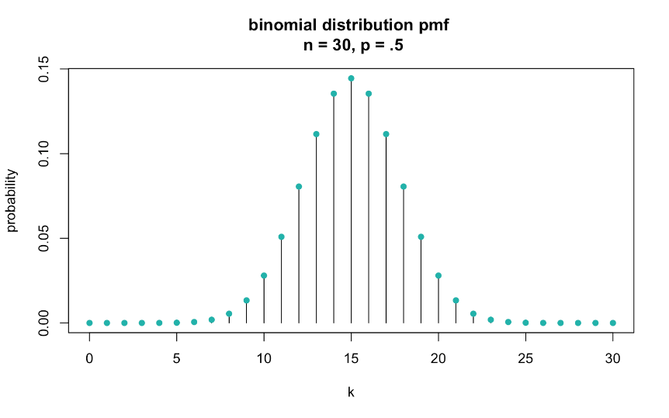
Before we peek:
What will be the center of this distribution?
What will be the shape: mode(s), skewness?
Notes:
Ask students
Symmetric?

Slide 29
Notes:
Values are known!! Using the binomial dist
That was fun!
Now what if I want to know for x<15?
I can sum (like above), but I also mentioned a cumulative probability

Slide 30
For all X, F(x) is a
Cumulative Distribution Function

Slide 31
Discrete rv: cumulative distribution function
(since x is used as a variable in the summation, we use “t” just as some other variable)
Notes:
F(x) is the cdf, f(t) is the pmf
Using t because x is taken
What are the requirements?

Slide 32
Cumulative distribution function

Slide 33
Notes:
Intuitive – as the pmf sums to 1, the cdf needs to approach 1

Slide 34
Notes:
If it didn’t, it would never sum to 1

Slide 35
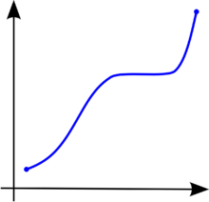
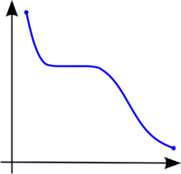
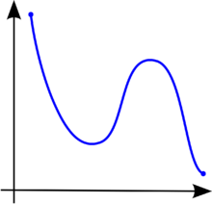
✗
✗
Notes:
Can’t go negative, as it’s additive

Slide 36
Let X count the number of heads (k) in n independent coin flips (again)…
Notes:
Let’s do an example..

Slide 37
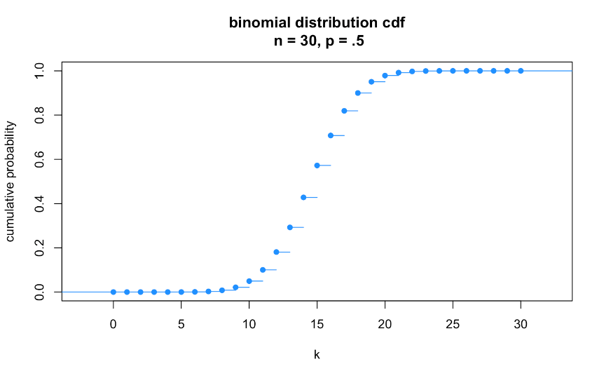
Before we peek:
What is the range on the y-axis?
Will it be smooth? Mound-shaped?
median (Q2) = 15
Notes:
0-1
Smooth- sideways s

Slide 38
median (Q2) = 15
> qbinom(.5, 30, .5) #Q2 (median)
[1] 15
Notes:
Inverse – feed it quantiles, like 50%
What does that last dot mean?
What is that R code giving me?

Slide 39
Q3: ≈17
Q1: ≈13
> qbinom(.25, 30, .5) #Q1
[1] 13
> qbinom(.75, 30, .5) #Q3
[1] 17
Notes:
More about qbinom

Slide 40

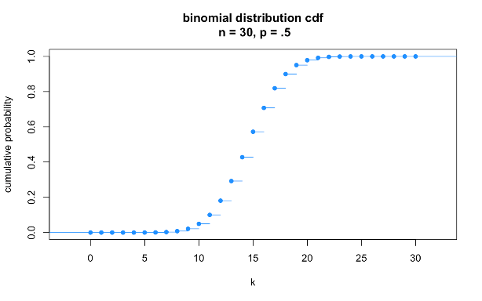
cumulative sum

Slide 41

Expectation of a
discrete random variable

Slide 42
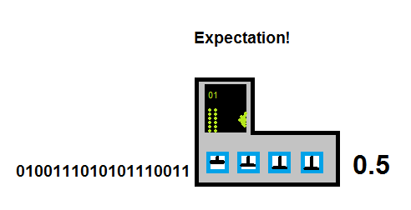
Expectation
The expectation of a random variable (X) is the sum of its values (x_{i}) weighted by their probability (p_{i}).
Output from random variable
Single number
Notes:
It’s like the Mean!!
Show an example:
3, 3, 5, 7, 7
Bernouli next

Slide 43
Expectation: Toss a fair coin 2 times

Slide 44

x
P(x)
E(x)
H
1 × .5
.5
H
H
2 × .25
.5
0 × .25
0
E(X)
1.0

Slide 45
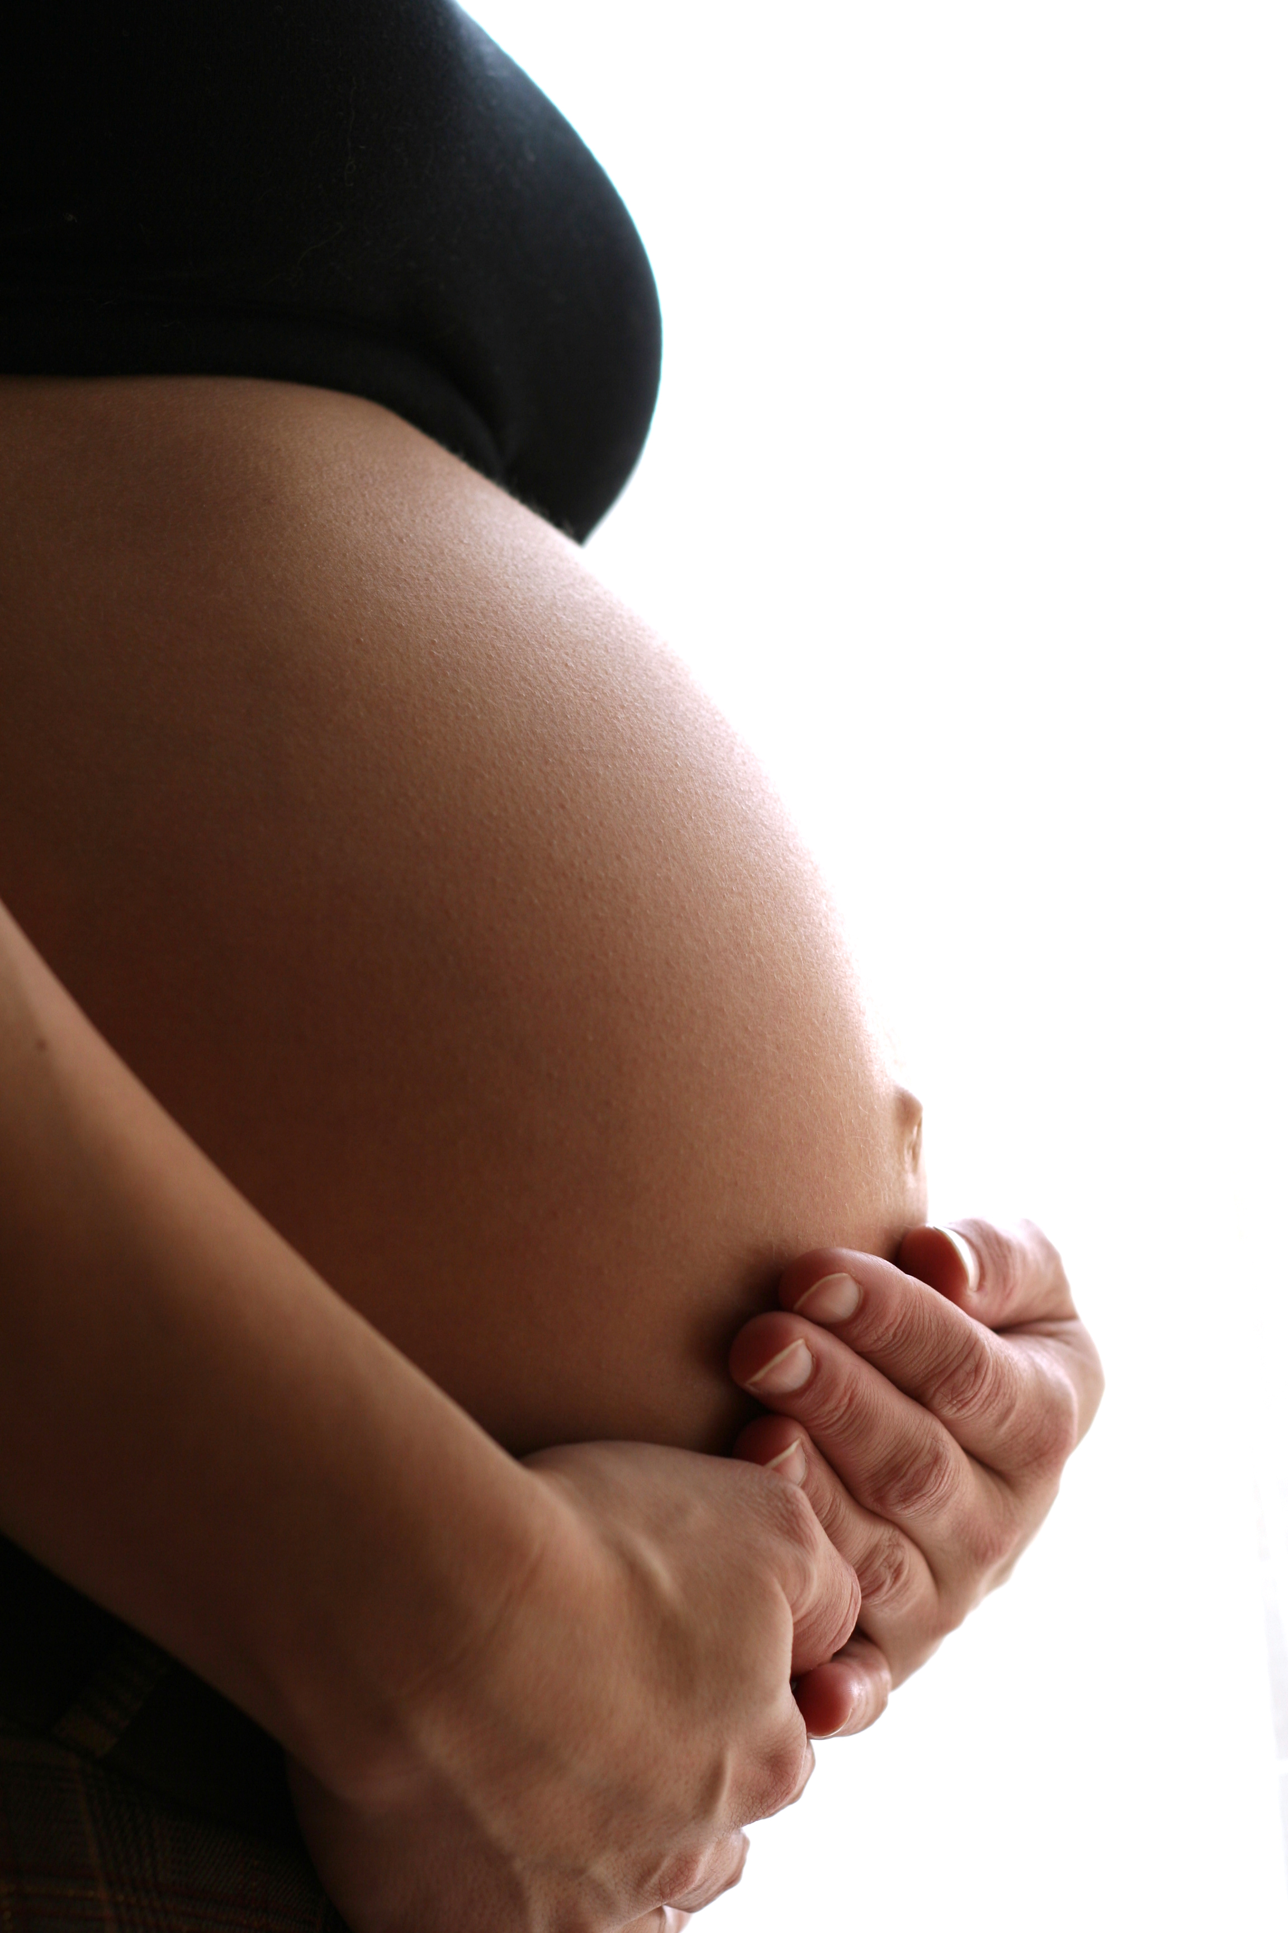
Expected values
The expected value estimates the population mean, 𝜇_{X}, for an rv with a given distribution
Example: families with fraternal twins
Random variable X: # of girls (discrete!)
Population: all families with fraternal twins
Expected value: the mean number of girls per families across all families with fraternal twins
Given that boys and girls are equally likely, what is 𝜇_{X}?

Slide 46

x
P(x)
E(x)
1 × .50
.5
2 × .25
.5
0 × .25
0
E(X)
1.0
Notes:
Binomial same as HT

Slide 47
Expected values: discrete distributions
Population mean
𝜇_{X}
pmf
For binomial, plug in pmf:
n = 2
p = .5
Notes:
General form for all discrete RVs
Try it on next slide…

Slide 48
Expected value of a binomial rv: the long way
= 0
= 1/2
= 1/2
R can help:
> choose(2,0)
[1] 1
> choose(2,1)
[1] 2
> choose(2,2)
[1] 1
Notes:
Two coin flips
(1/2)^2 = p^{k} (1-p)^{k k=2}

Slide 49
Variance of a discrete random variable
Notes:
When using or comparing means, typically also need a measure of spread.

Slide 50
Population variance for discrete rv
The variance is the expected value of the square of the deviation of X from its own mean
Notes:
General Form
---------------
Just like variance of a dataset – the mean of the squared distances
The last formula can be derived – look it up if interested
One way
x p x^2
0 .25 0 0
1 .5 1 .5
2 .25 4 1
1.5 E(X²)
1 (E(X))²
.5 = Var(X)
Another way – next slide

Slide 51
Population variance for discrete rv
The variance is the expected value of the square of the deviation of X from its own mean
pmf →
probabilities!
Notes:
Ux = E(X)
Do it with coin flip
minus E(X) ()² *p(x)
0 1 -1 1 .25 .25
1 1 0 0 .50 0
2 1 1 1 .25 .25
.50 Var(X)
There’s an easier way…..

Slide 52
Expected value and variance of a binomial rv: the short ways
Notes:
Example??
Makes sense with a single coin flip….

